Slide 1
Kritika Kaur
Technical Manager and Radiological Safety Officer at Nuvia India
India Energy Forum - 2019
Designed to Deliver

Slide 2
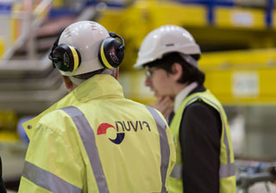
Radioactive Waste Management in Healthcare and Research sector

Slide 3
Introduction
Radionuclides, in the form of sealed and unsealed sources, are extensively used in medicine, industry, agriculture, research and various other applications.
Such applications could result in generation of significant quantities of solid and liquid wastes and occasionally gaseous wastes.
The management of waste arising from the use of radionuclides requires effective planning and provision of adequate facilities at institutional and/or national level.
The topic covers the managerial, administrative and technical procedures related with safe handling and management of radioactive waste, from its generation to its release from further regulatory control through a clearance mechanism, or its acceptance at storage or disposal facility.

Slide 4
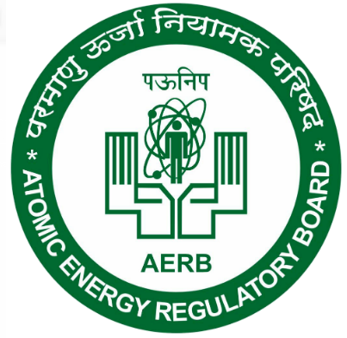
AERB Rules
Safety code of Atomic Energy Regulatory Board (AERB) titled ‘Management of Radioactive Waste’ (AERB/NRF/SC/RW, 2007).
Management of spent radioactive Sources and radioactive waste arising from the use of radionuclides in Medicine, industry and research, Including decommissioning of Such facilities AERB safety guide no. AERB/R/SG/RW-6
Atomic energy (safe disposal of radioactive wastes) rules, 1987.

Slide 5
Medical and Research applications
Medical Applications:
Both “in vitro” and “in vivo” applications.
In vitro - studies performed on human biological samples outside of the human body
in vivo - dynamic function studies within the human body.
In vitro applications typically involve kBq activities of aqueous-based radionuclides being utilized to measure levels of drugs or hormones in biomedical samples.
Typical radionuclides include I-125, Co-57 and C-14.
By far the greatest diagnostic application of radionuclides in medicine is in vivo investigation of body function using gamma camera imaging. Many in vivo radiopharmaceuticals are prepared by diluting a pharmaceutical with 99mTc, which is eluted from a 99mTc generator.
Research Applications:
Isotopes such as H-3, S-35, P-32 and P-33 are widely used for DNA sequencing in research.

Slide 6
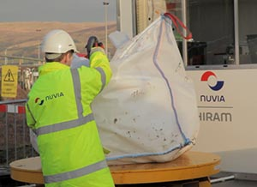
Classification of wastes
Solid waste
Cover papers, gloves, empty vials and syringes.
Radionuclide generators. Items used by hospitalized patients after radionuclide therapy.
Sealed sources used for calibration of instruments.
Animal carcasses and other biological waste.
Liquid waste
Residues of radionuclides. Patient excreta. Liquid scintillation solutions.
Gaseous waste
Exhausted gas from patients in nuclear medicine

Slide 7
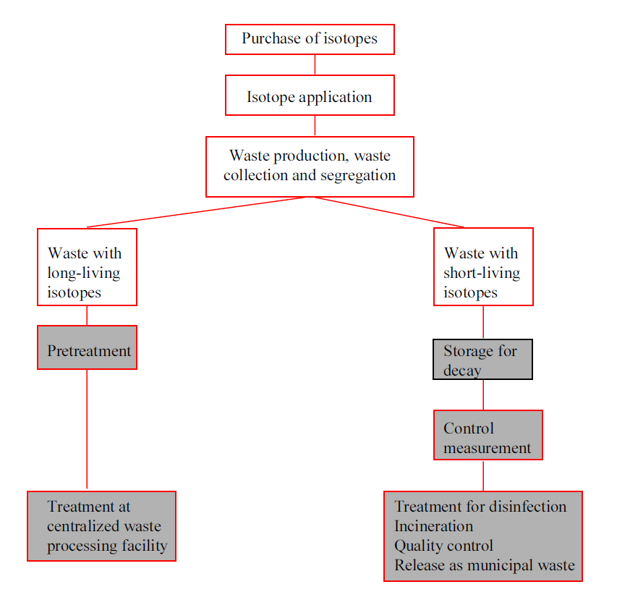
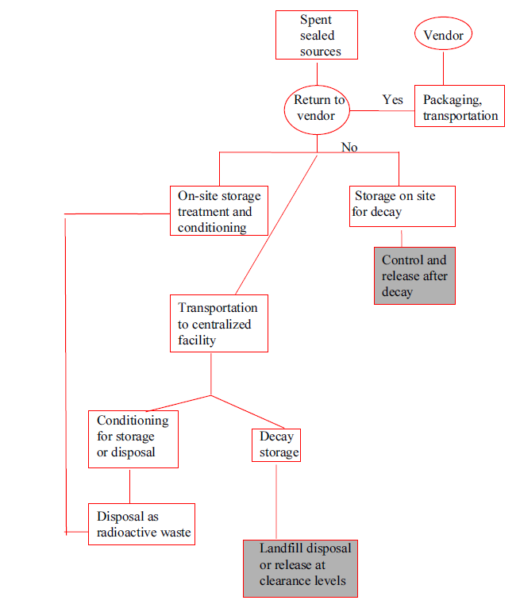
Management of Biomedical radioactive waste and spent sealed sources

Slide 8
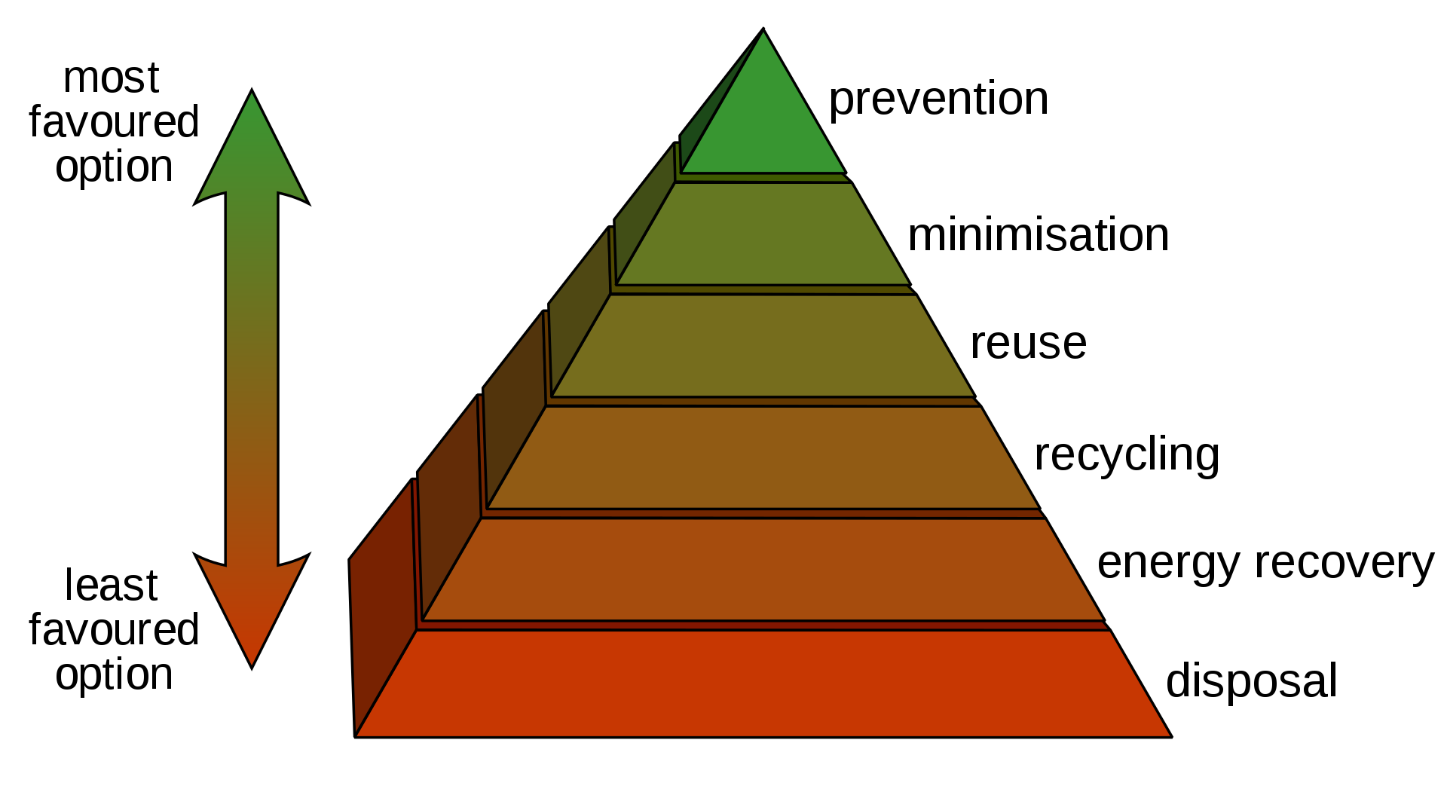
Management of radioactive waste
Radioactive waste shall be managed in such a way as to secure and provide an acceptable level of protection for human health and environment.
Radioactive waste shall be managed within an appropriate national legal framework including clear allocation of responsibilities and provision for independent regulatory functions.
Generation of radioactive waste shall be kept to minimum practicable.

Slide 9
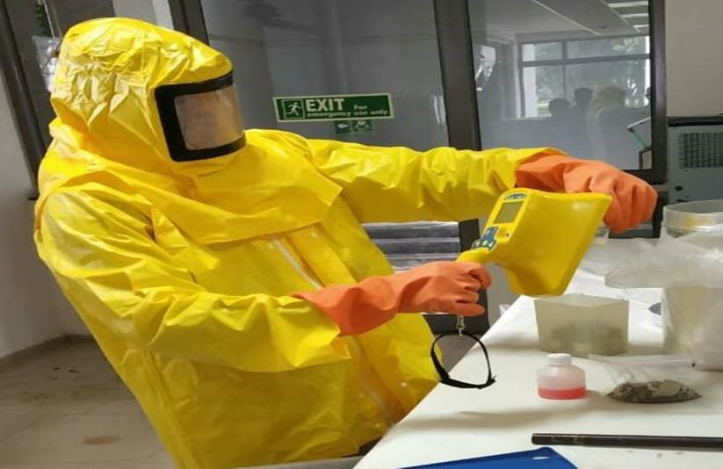
Pre-disposal management
Waste Minimisation and Control
    Reduce the activity and the volume of wastes for storage, treatment and disposal
    Recycle and reuse radioactive material and equipment
Characterisation, Categorisation and Segregation
    Characterized according to its physical and chemical nature, physical half-life of radionuclide present in it, chemical toxicity, radio-toxicity and presence of flammable/non-flammable material.
    Waste Categorized as per the AERB safety guide titled ‘Classification of Radioactive Waste’, AERB/NRF/SG/RW-1.
    Nonradioactive waste should not be mixed or collected along with radioactive waste.
Collection of Radioactive Waste
Storage of Radioactive Waste
    Waste with short half-life and small quantity of radionuclides should be stored at the site for physical decay of activity. The waste with long half-life and high level of radioactivity should be packed and stored in interim facility after segregation, treatment and conditioning or final disposal.
Pre-treatment
    Method of collection, segregation, chemical adjustment and decontamination.
Treatment and Conditioning
    Includes those operations intended to provide for safety or economy by changing the characteristics of the waste. The basic treatment concepts applicable are volume reduction, removal of radionuclides and change of composition.
Radiation measurement prior to disposal with Nuvia contamination monitor-COMO

Slide 10
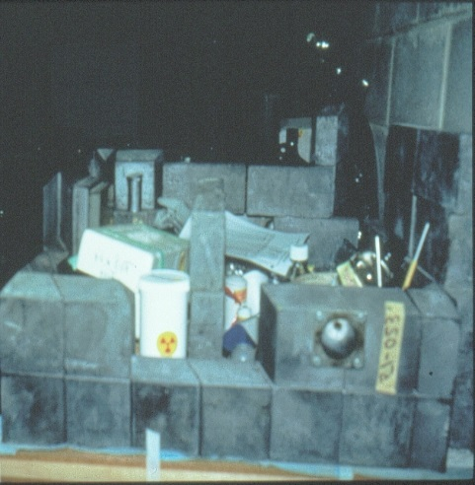
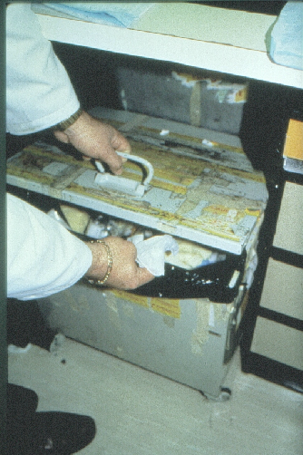
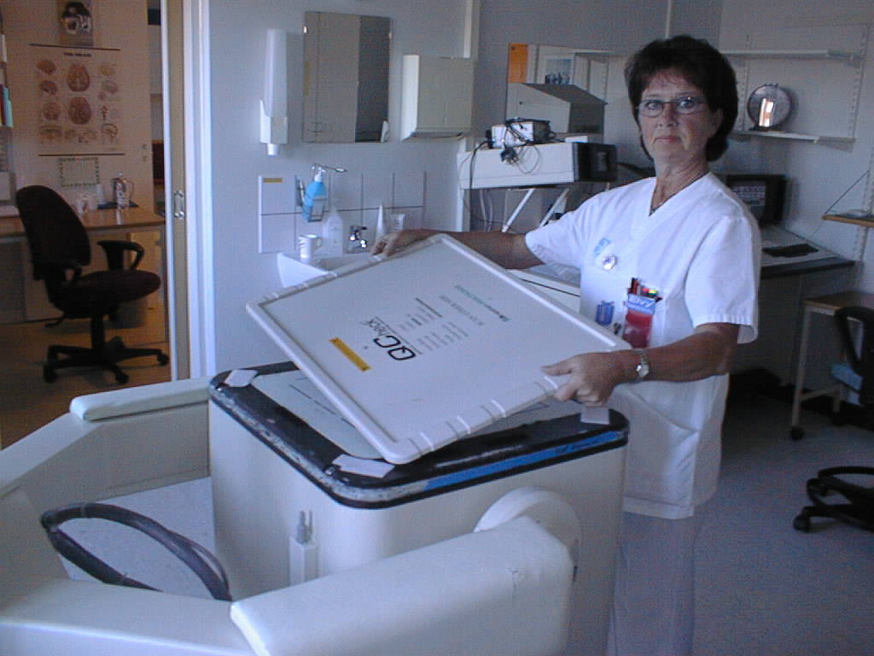
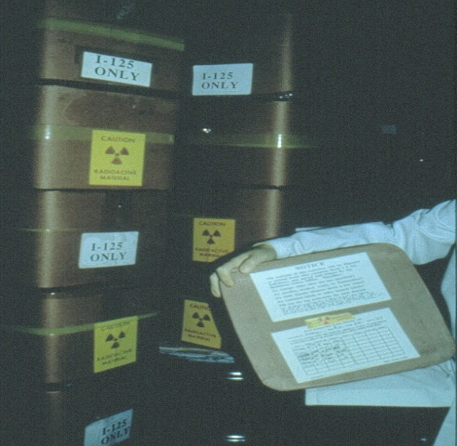
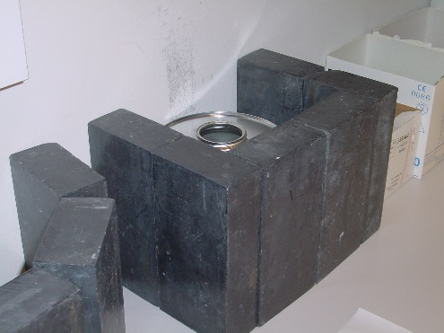
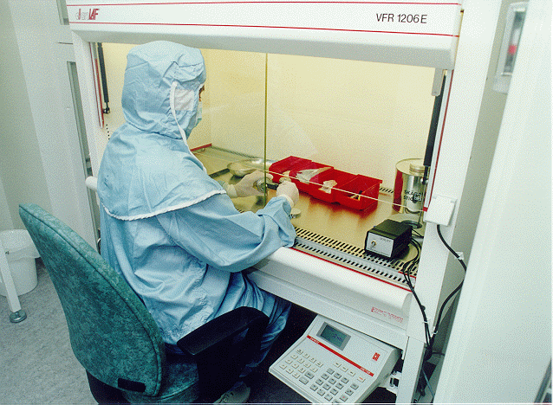
Pre-disposal Management
Storage
Segregation
Pre-treatment

Slide 11
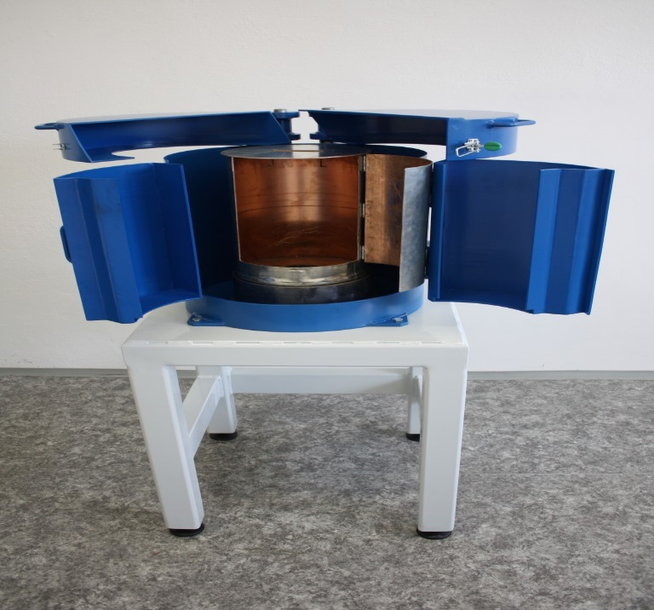
Transport and disposal of Radioactive waste
Criteria for Transport-Safety Code for the Transport of Radioactive Materials, AERB/SC/TR-1, 1986
Disposal of Solid Waste
Group- contamination levels, associated radionuclides and the quantity
Such waste should be locally buried or incinerated with the consent of the AERB after providing for adequate decay of activity. In all the above cases, authorisation from regulatory body prior to disposal should be obtained as required under the Atomic Energy (Safe Disposal of Radioactive Wastes) Rules, 1987, G.S.R. 125.
Disposal of liquid waste
Classified as aqueous or non-aqueous (organic)
Aqueous liquids should be treated and the activity concentration levels in the liquid effluent should be brought down to authorised limits prior to discharge into appropriate environment.
Disposal of gaseous waste
HEPA filter
Discharges of airborne releases should be within the authorised limits specified by AERB.
Nuvia-Nulab-Box with lead shielding

Slide 12
Project References

Slide 13
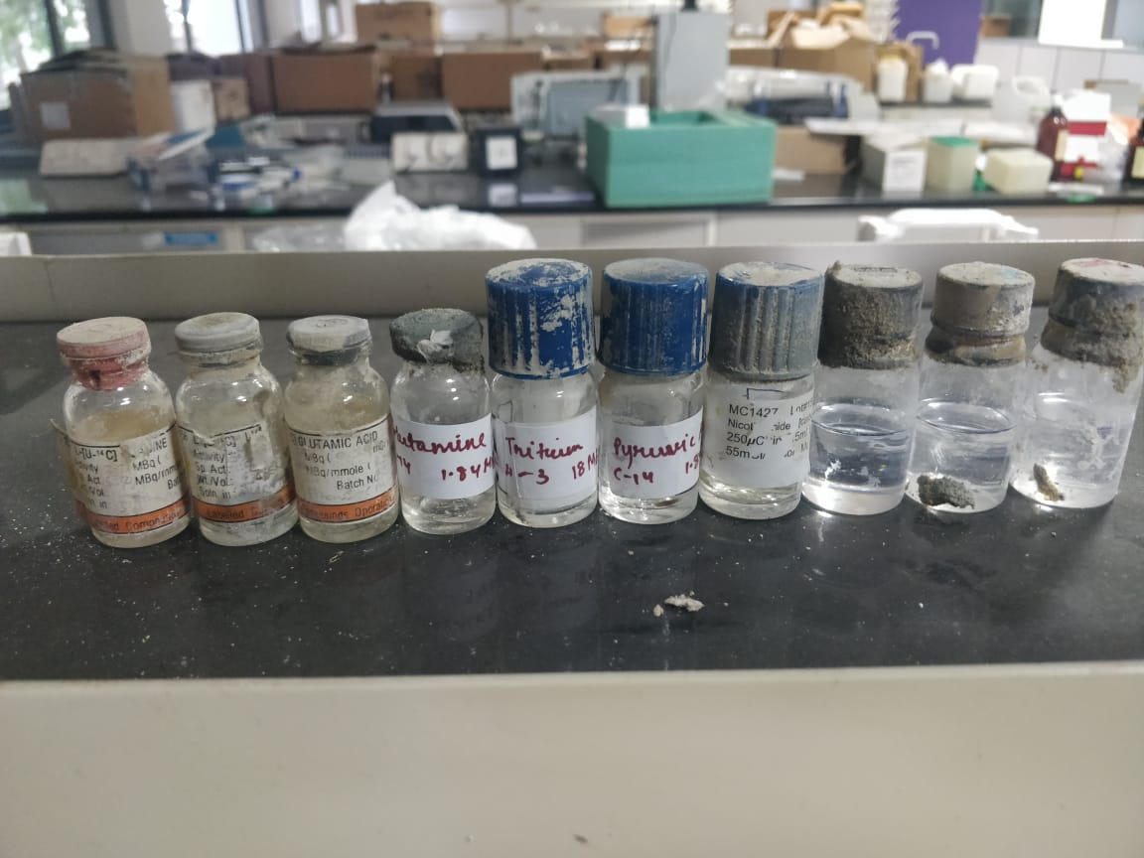
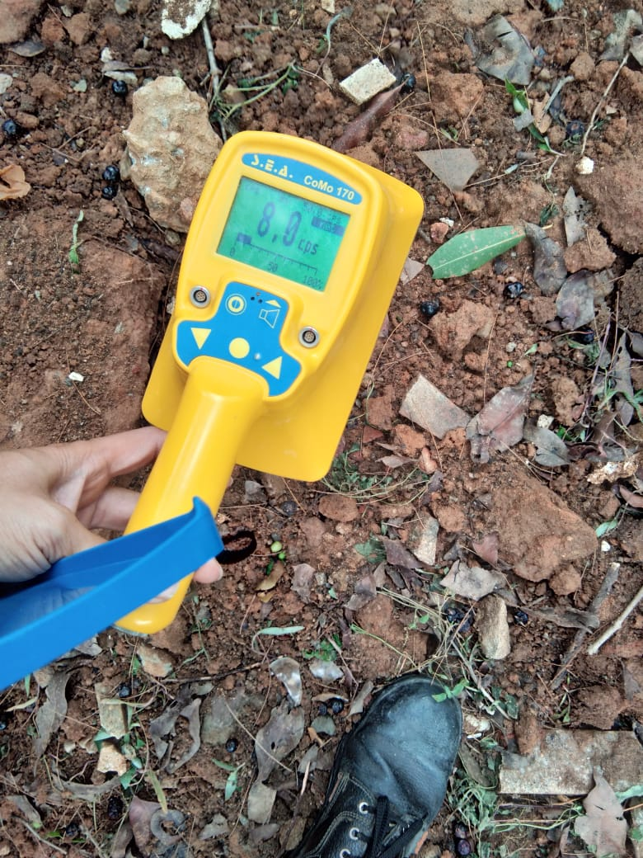

Decommissioning of Radioactive disposal Pit : Unilever Bangalore
Unilever R&D had a radioactive waste disposal pit where they had disposed off low activity radioactive chemicals which were mainly amino-acids and various non-contaminated items that were used in their radio-chemistry laboratory.
These materials were disposed in pit as per AERB guidelines in the year 2009 & 2016. The client wanted to extract these radioactive materials from pit and dispose off permanently as per AERB guidelines.
Thus, NUVIA consulted & worked with Unilever to “Recover Disposal Pit Safely From Ground”, “Retrieve Radioisotope Chemicals From Pit”, “Dispose Retrieved Chemicals As Per AERB Guidelines” & “Decommission Pit As Per AERB Guidelines”.
NUVIA successfully completed this activity.

Slide 14
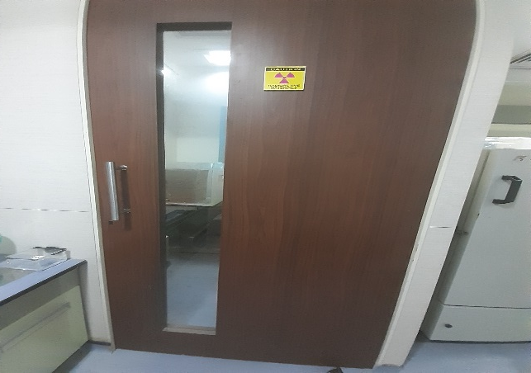
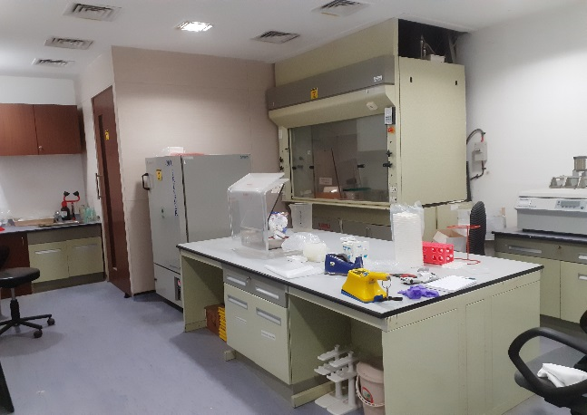
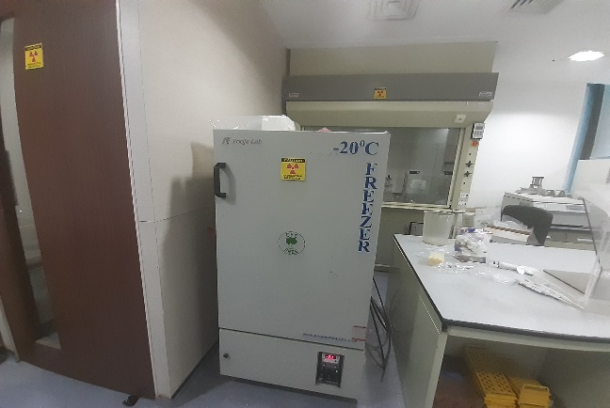

Decommissioning of Radiobiology laboratory: Lupin Research Park Pune
Consultancy for safe shifting of Radioactive chemicals to New facility from old facility.
Consultancy on Atomic energy (safe disposal of radioactive wastes) rules, 1987.
Swipe test of entire laboratory
The area was decontaminated with decontamination chemicals and the site was totally cleared of radioactivity.
Site ready for decommissioning.

Slide 15
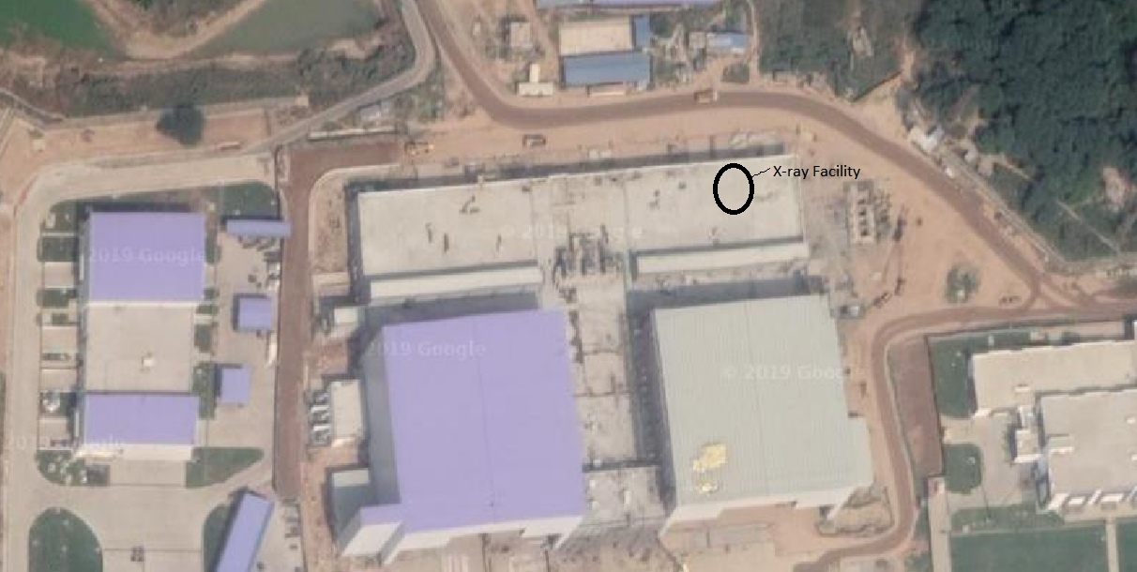

Design, Engineering, Certification Consultancy Services for X-Ray Facility: L&T ECC
Consultancy for Design and engineering of Lead shielding of X-ray facility for Non Destructive Testing of aircraft components in Hangar facility at Hindon Airbase, Ghaziabad

Slide 16
FRM reference example: SUE SIA “RADON” in Russia
RADIOLOGICAL CHARACTERIZATION SYSTEM
  Stationary system with HPGe detector and a conveyer for 25 drums for automatic RW measurement
  2 mobile systems with HPGe detector and a turntable ISO-CART + MCA DigiDart device SW GamControl, RAOS, GamaVision, Isotopic 32
  Generating reports for the State control and accounting system of RW&RM

Slide 17
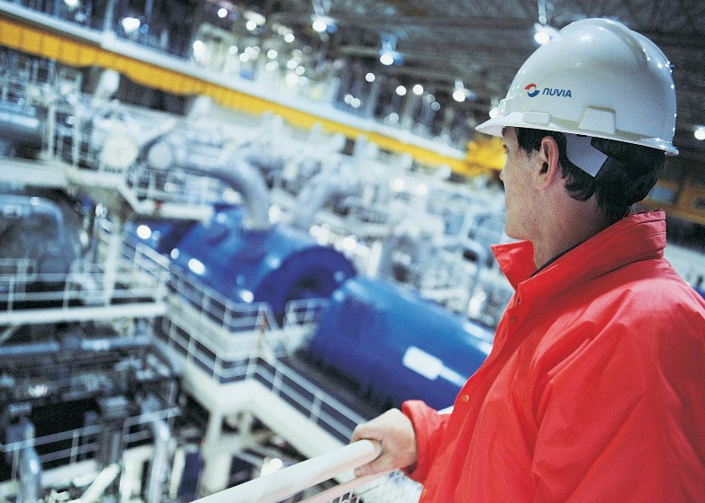
FRM reference example: LITHUANIA, IGNALINA NPP
NPP UNDER DECOMMISSIONING
Stationary and mobile systems for RW free release measurement which determines the possibility of waste release into the environment
PROCUREMENT OF TOOLS AND EQUIPMENT FOR RADIOLOGICAL CHARACTERIZATION
  Supply and installation of the measuring and laboratory equipment
  Development of radiochemical methods & procedures
  Creation of the system database
  for archiving and presentation of
  the measured data
  Training of radiochemical
  laboratory personnel

Slide 18

Decommissioning a Facility Contaminated with Beryllium, Radioactivity and Asbestos
Client: Research site restoration Limited, UK
Contract awarded to Nuvia to undertake a comprehensive Health Physics survey and to subsequently decommission the facility.
Phase 1: Decommissioning Strategy established
An intrusive Health Physics survey was undertaken to measure radiation and contamination levels throughout the facility, including all associated drainage systems and the surrounding land.
Based on the resultant data, a full safety case was produced for decommissioning the facility.
Phase 2: Mobilisation followed endorsement of the safety case.
Included provision of a mobile personnel decontamination station that divided the building into ten discrete areas for the purpose of contamination control.

Slide 19
Nuvia India Private Ltd.
E-11, B-1 Extension, Mohan Co-operative Industrial Estate, New Delhi
011-49384300
info@nuvia-india.com
www.nuvia-group.com

